Slide 1
RNA-Seq Analysis
Practice with RNA-Seq data from paper “Rinf Regulates Pluripotency Network Genes and Tet Enzymes in Embryonic Stem Cells”

Slide 2
Raw data stats
SampleName | UntrimmedReads | TrimmedReads
MD-R-EB-10 | 48,343,253 | 48,329,476
MD-R-EB-11 | 49,008,831 | 48,995,334
MD-R-EB-12 | 51,154,870 | 51,139,532
MD-R-EB-1 | 40,029,245 | 40,011,847
MD-R-EB-2 | 46,488,436 | 46,480,471
MD-R-EB-3 | 40,853,439 | 40,844,519
MD-R-EB-4 | 32,206,594 | 32,202,135
MD-R-EB-5 | 56,833,633 | 56,818,908
MD-R-EB-6 | 27,191,032 | 27,174,716
MD-R-EB-7 | 50,171,104 | 50,157,734
MD-R-EB-8 | 59,266,962 | 59,252,659
MD-R-EB-9 | 47,052,723 | 47,030,383

Slide 3
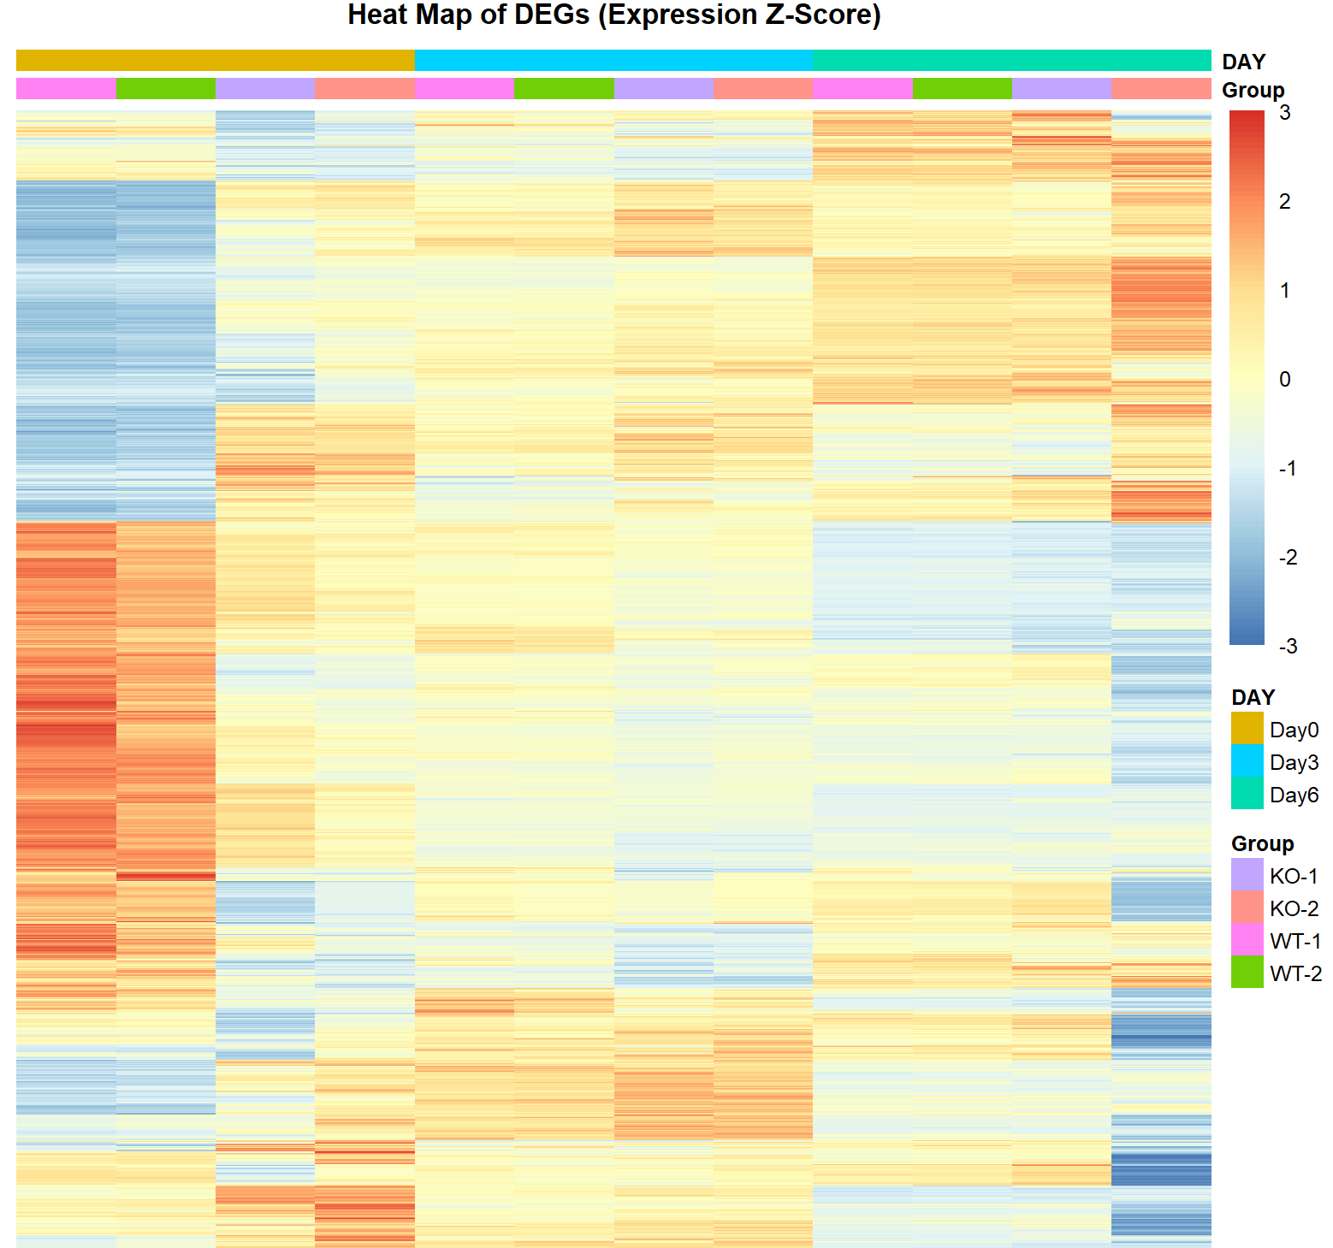
Heatmap of DEGs identified at the indicated time points during differentiation to EBs

Slide 4
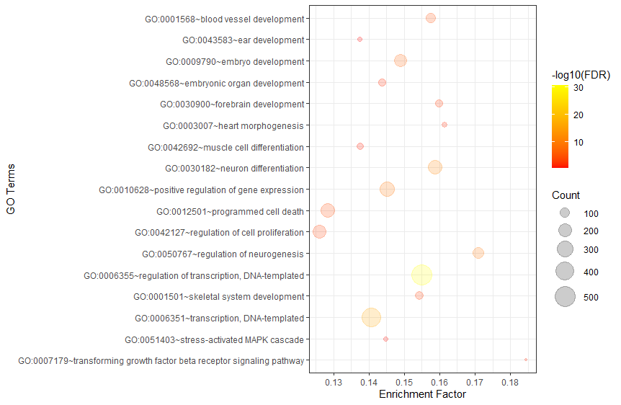
GO enrichment and KEGG pathway analysis of the DEGs at day 6 of differentiation to EBs.

Slide 5
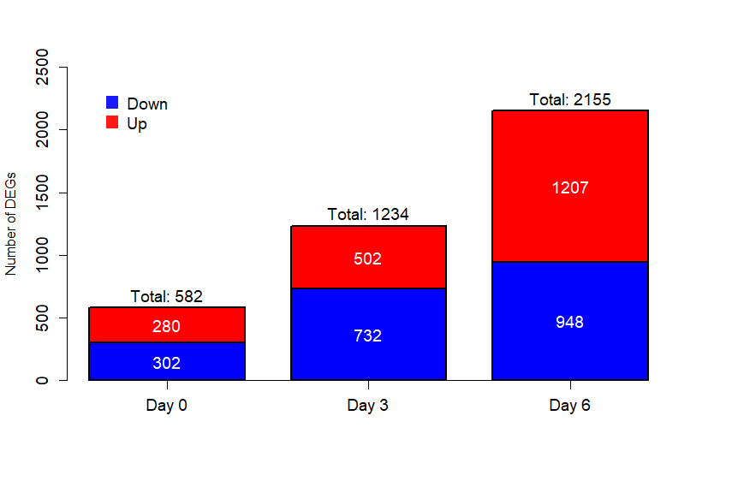
Barplot for Number of DEGs

Slide 6
Venn diagram illustrating overlap of DEGs between wild-type and Rinf–/– EBs for each time point during differentiation.

Slide 7
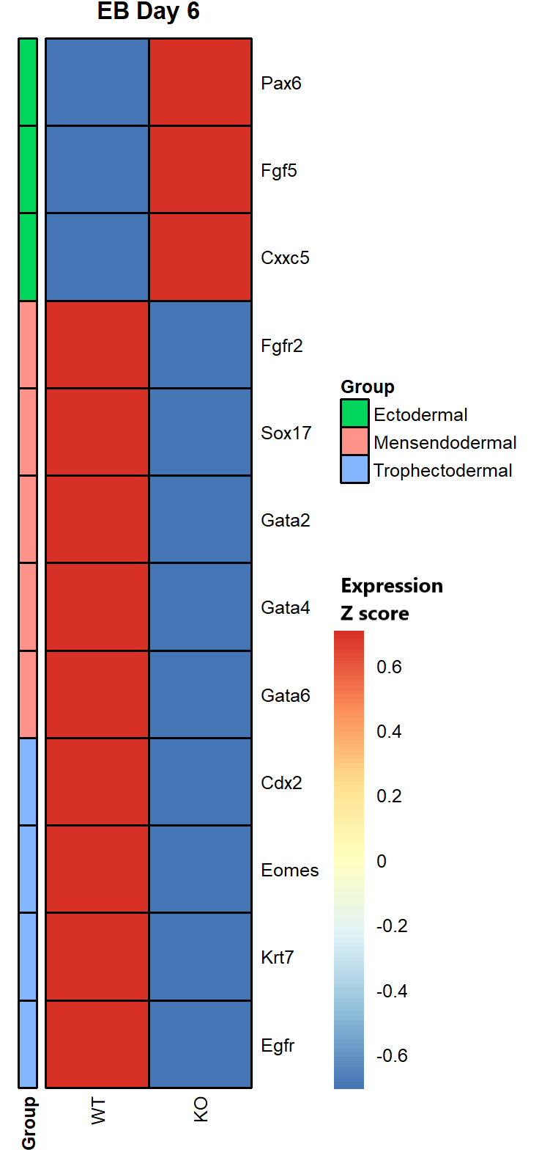
Heatmap: Expression patterns of deregulated lineage marker genes at day 6 of differentiation

Slide 8
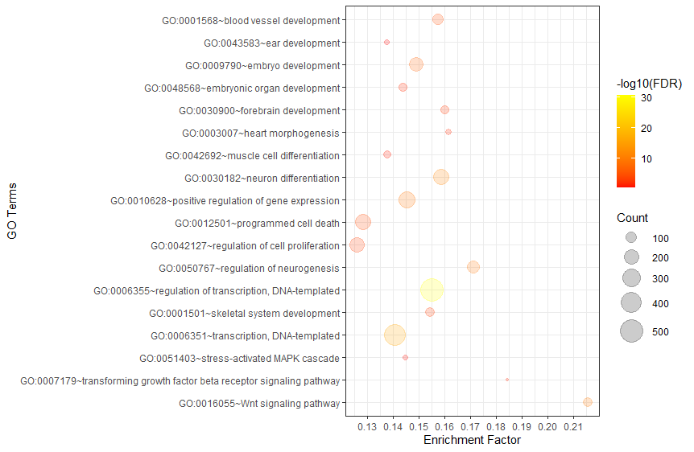
Wnt signaling pathway (New finding).

Slide 9
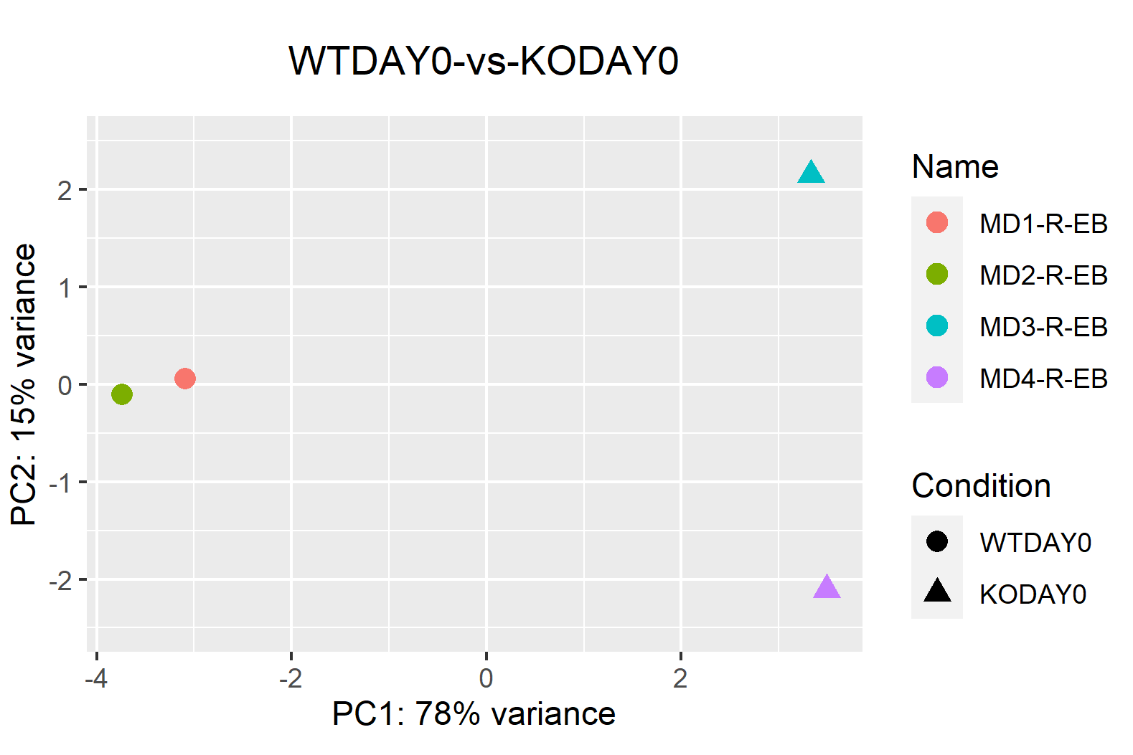
Additional plots: PCA Plots

Slide 10
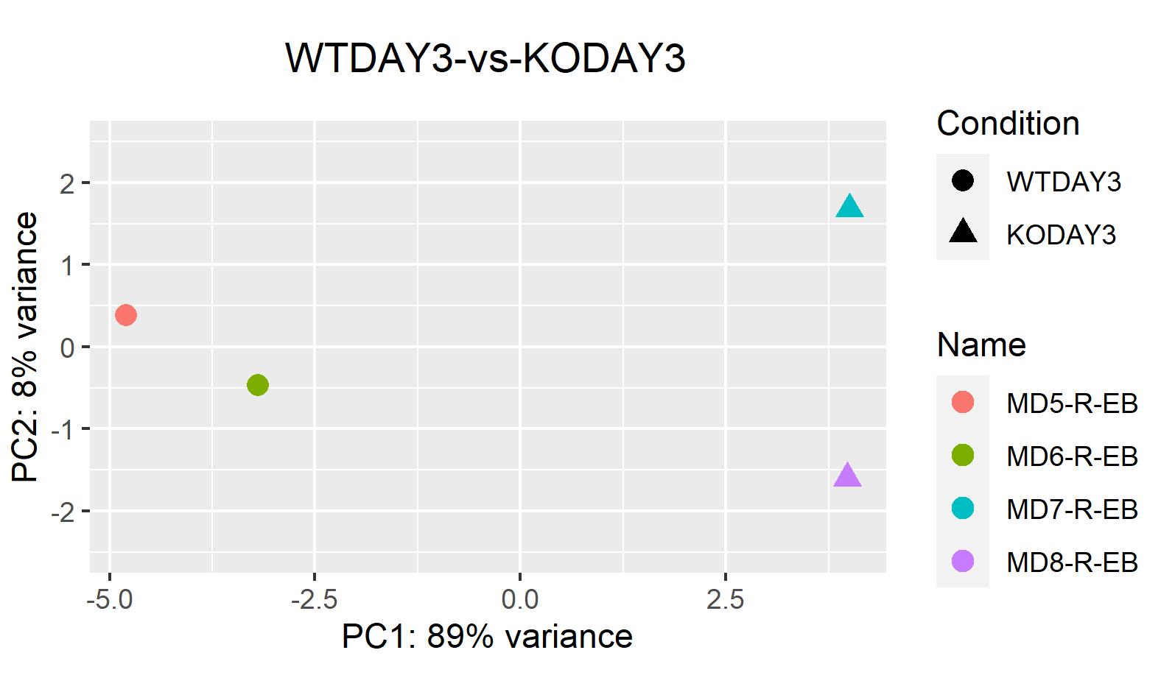
Additional plots: PCA Plots

Slide 11
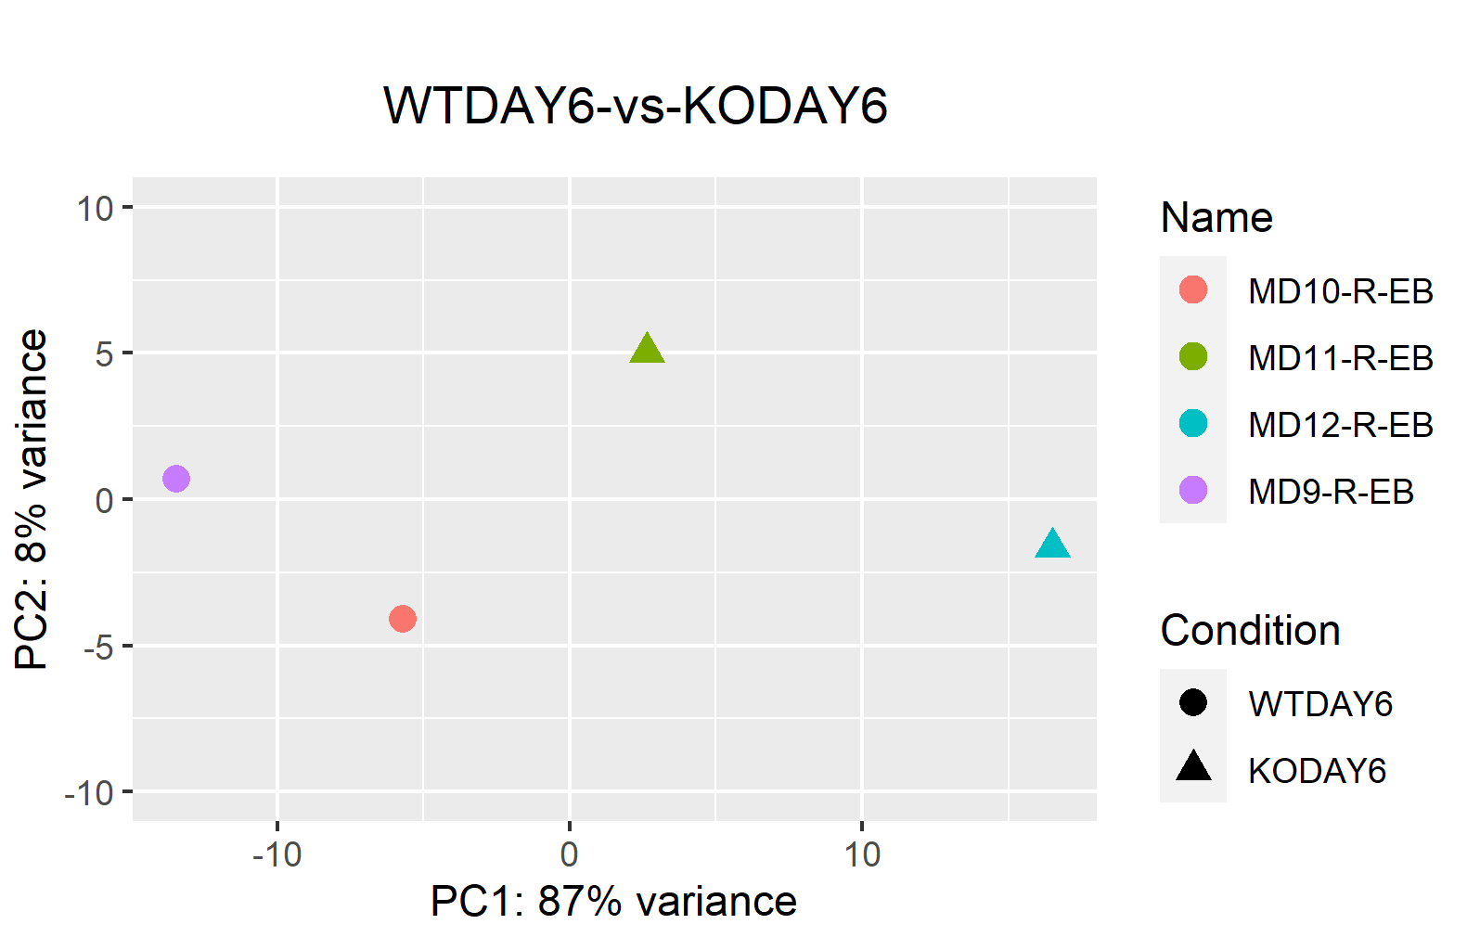
Additional plots: PCA Plots

Slide 12
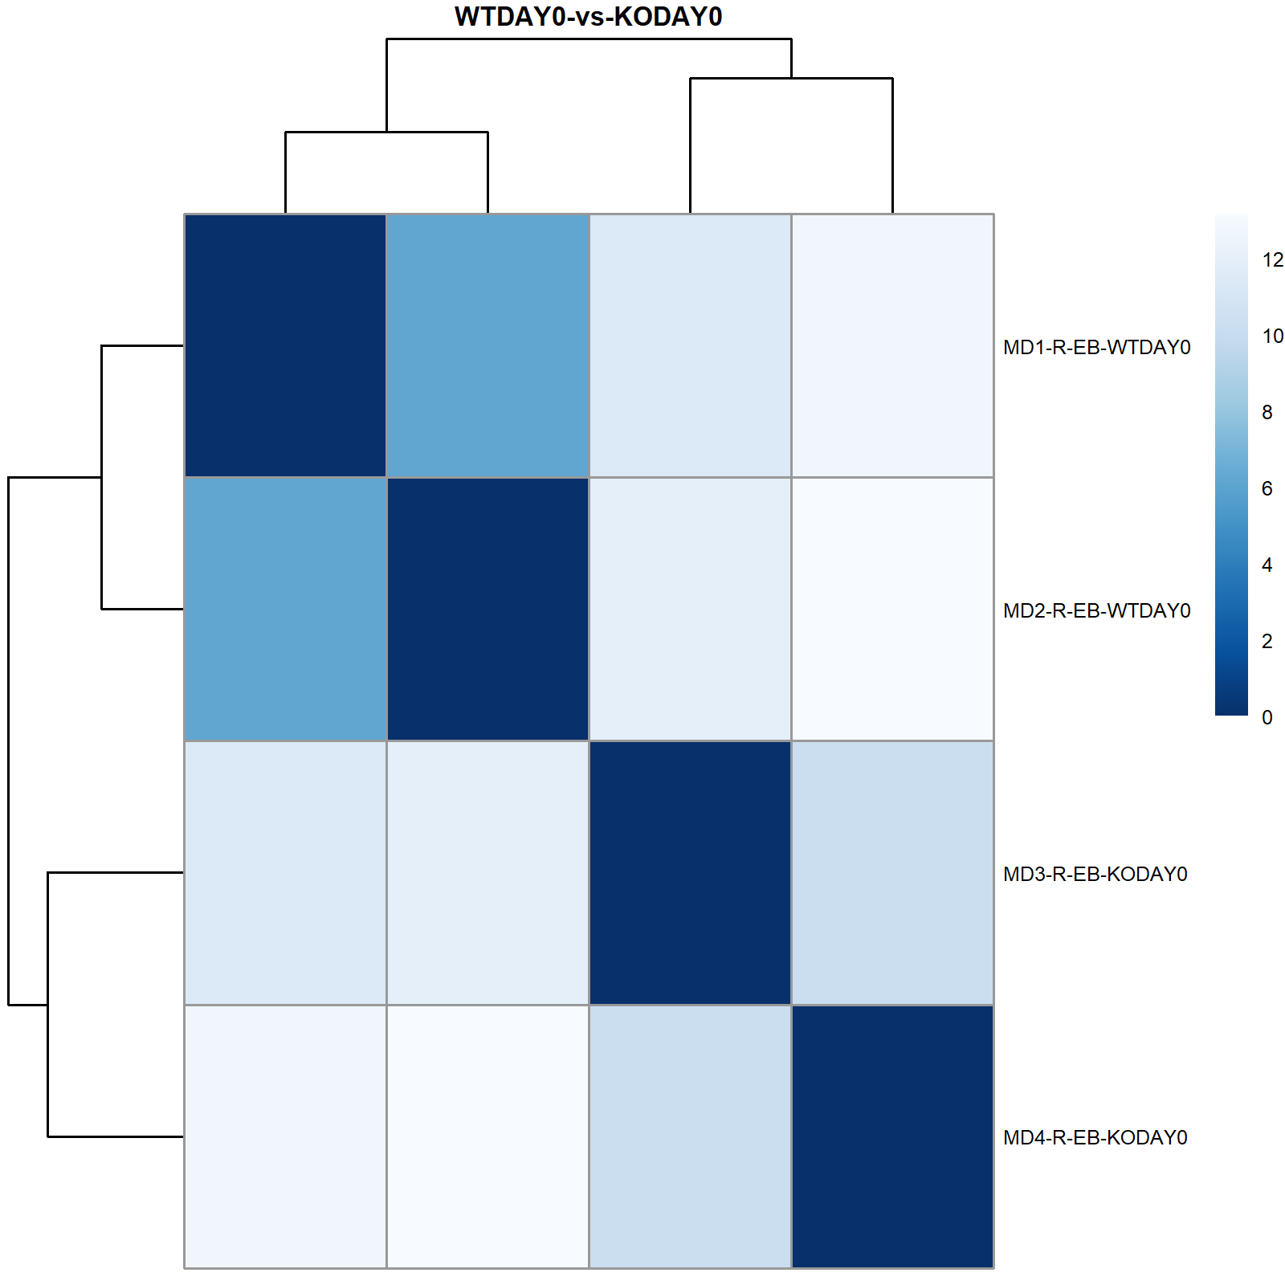
Additional plots: Sample Distance Heatmap Plots

Slide 13
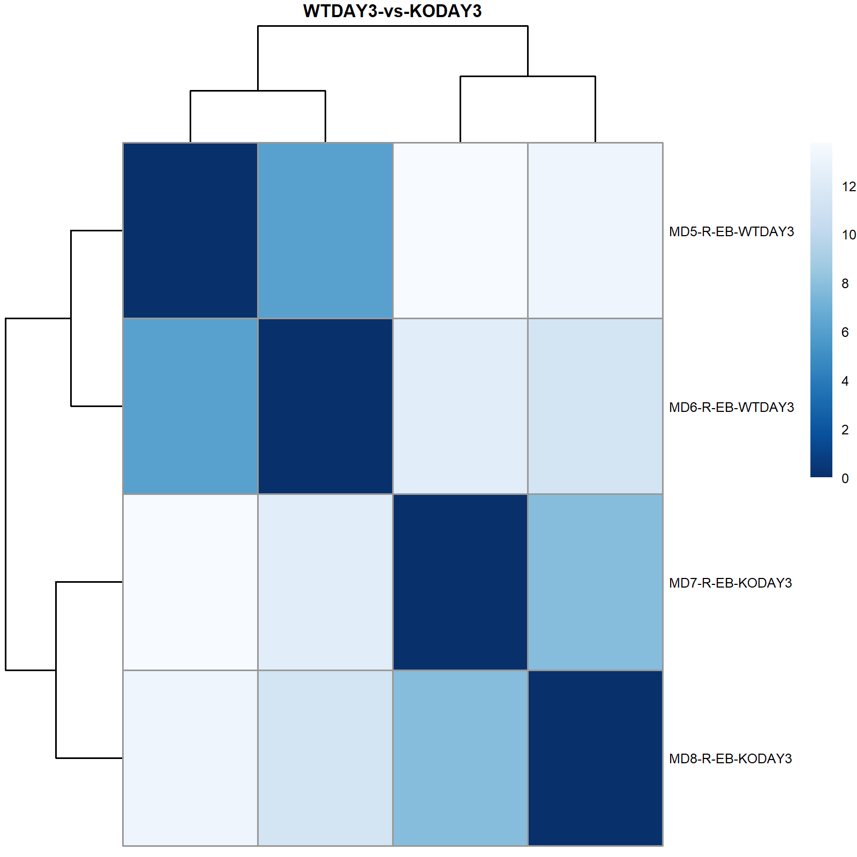
Additional plots: Sample Distance Heatmap Plots

Slide 14
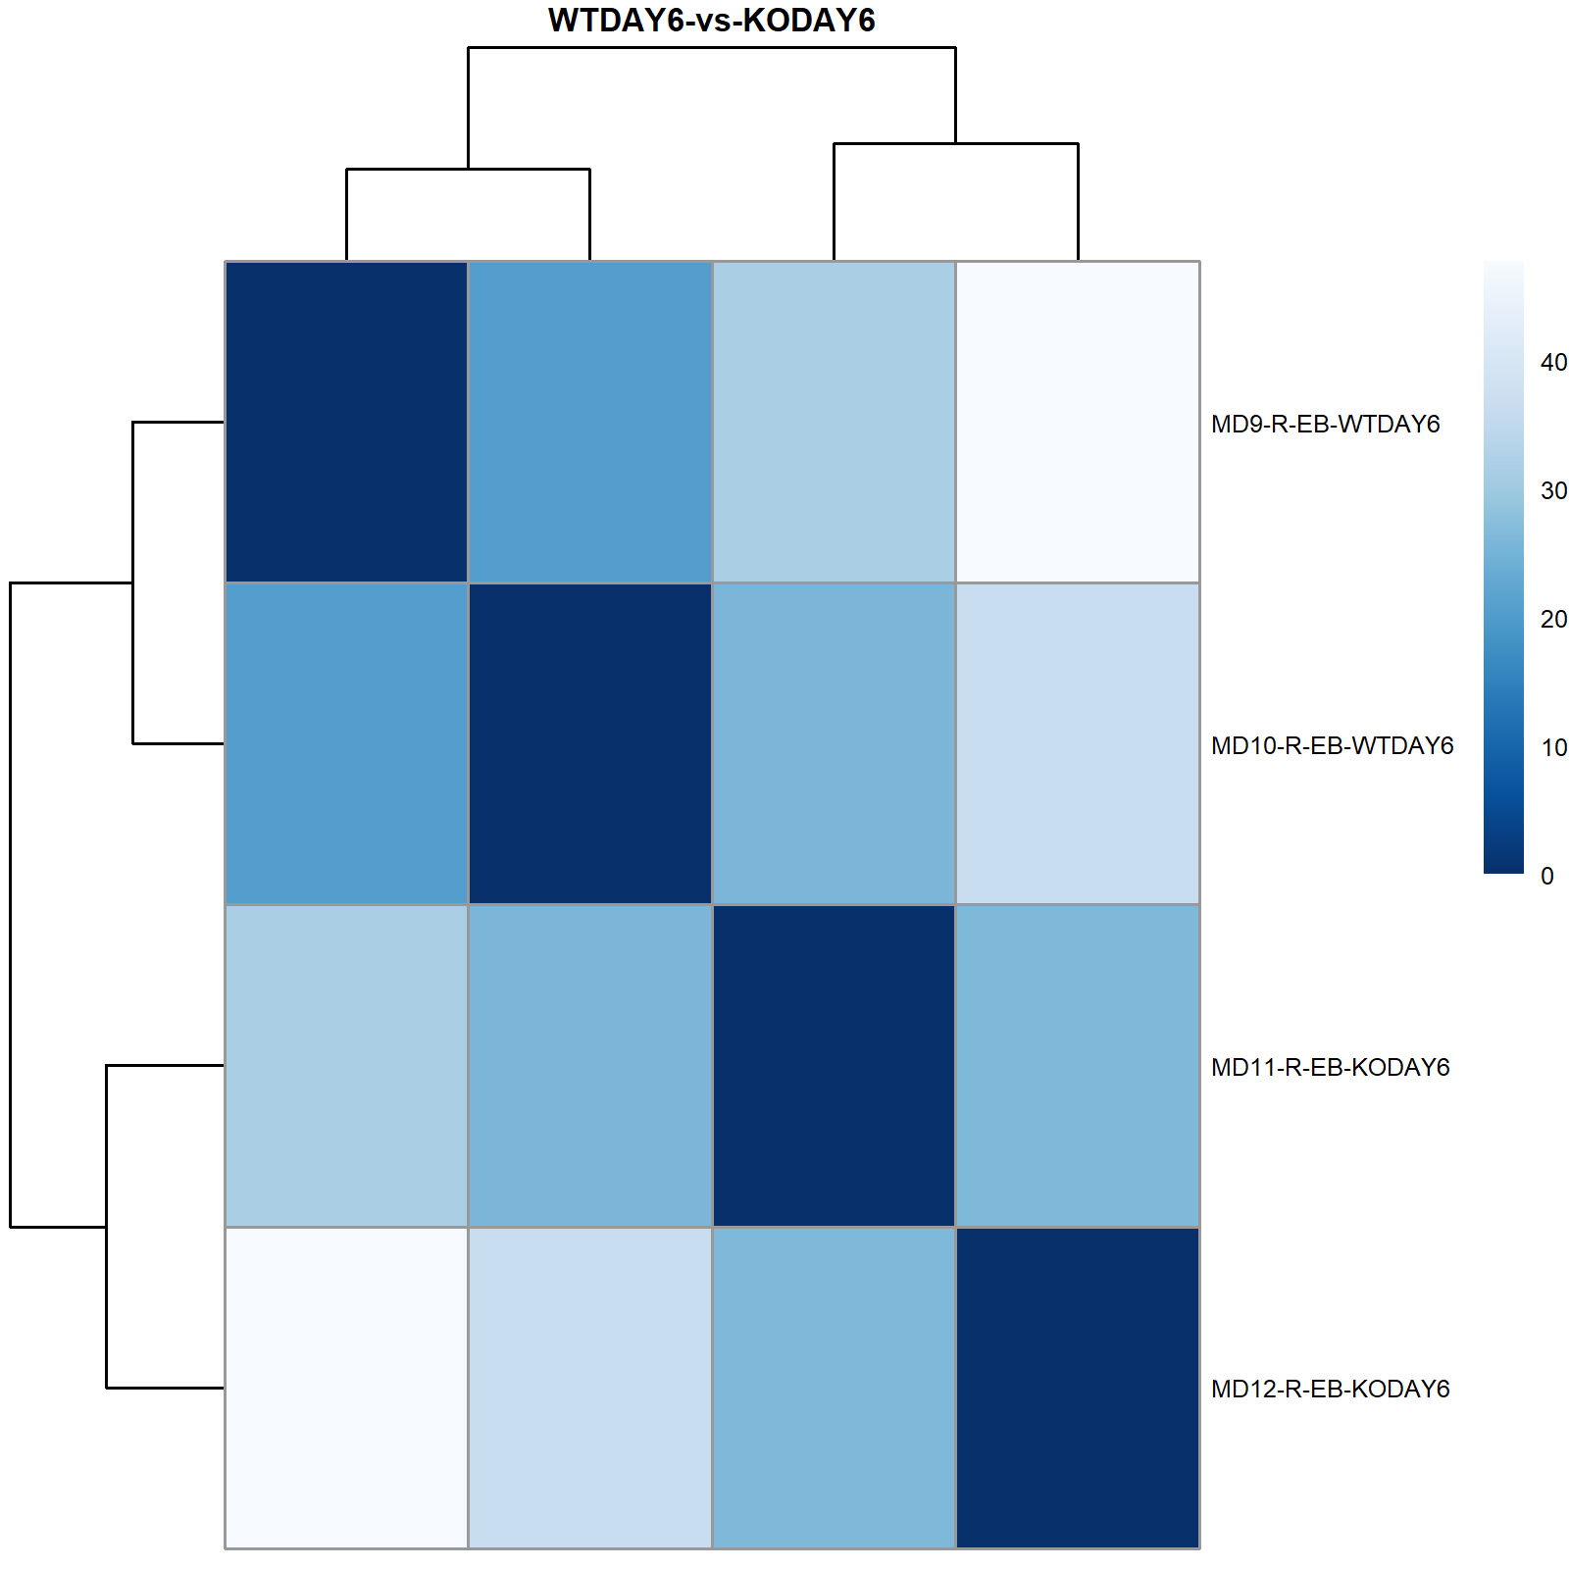
Additional plots: Sample Distance Heatmap Plots

Slide 15
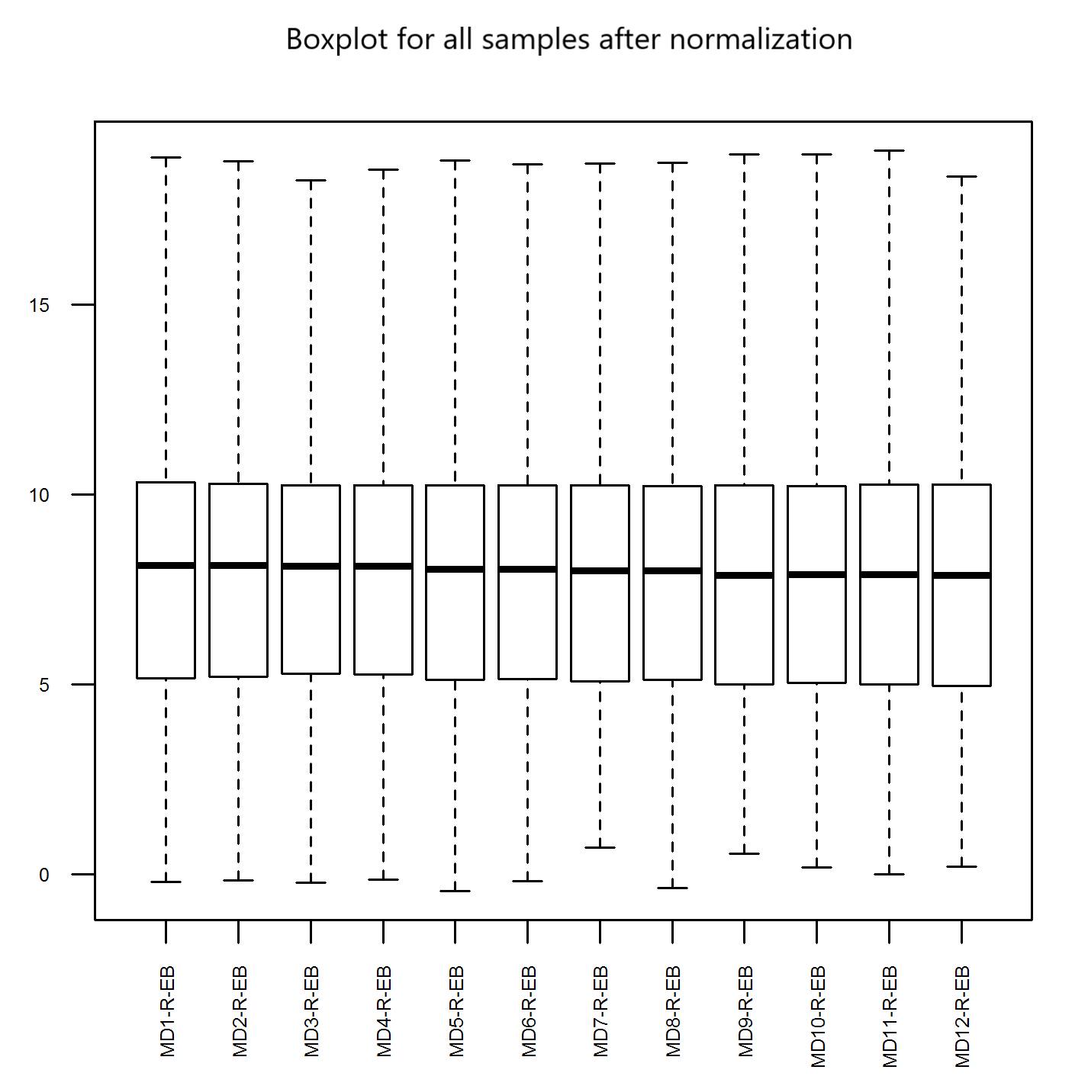
Additional plots: Boxplot for all samples after normalization

Slide 16
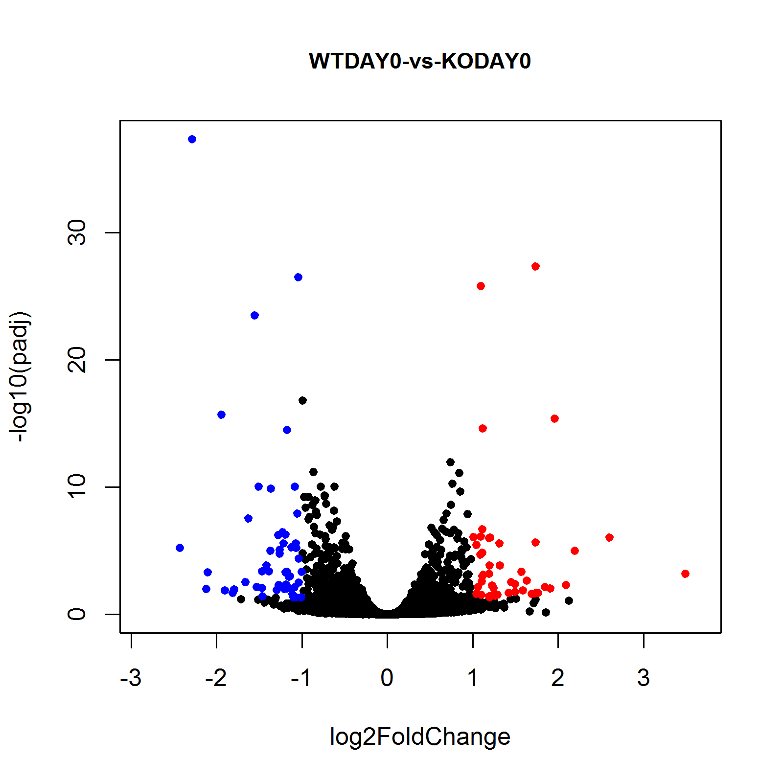
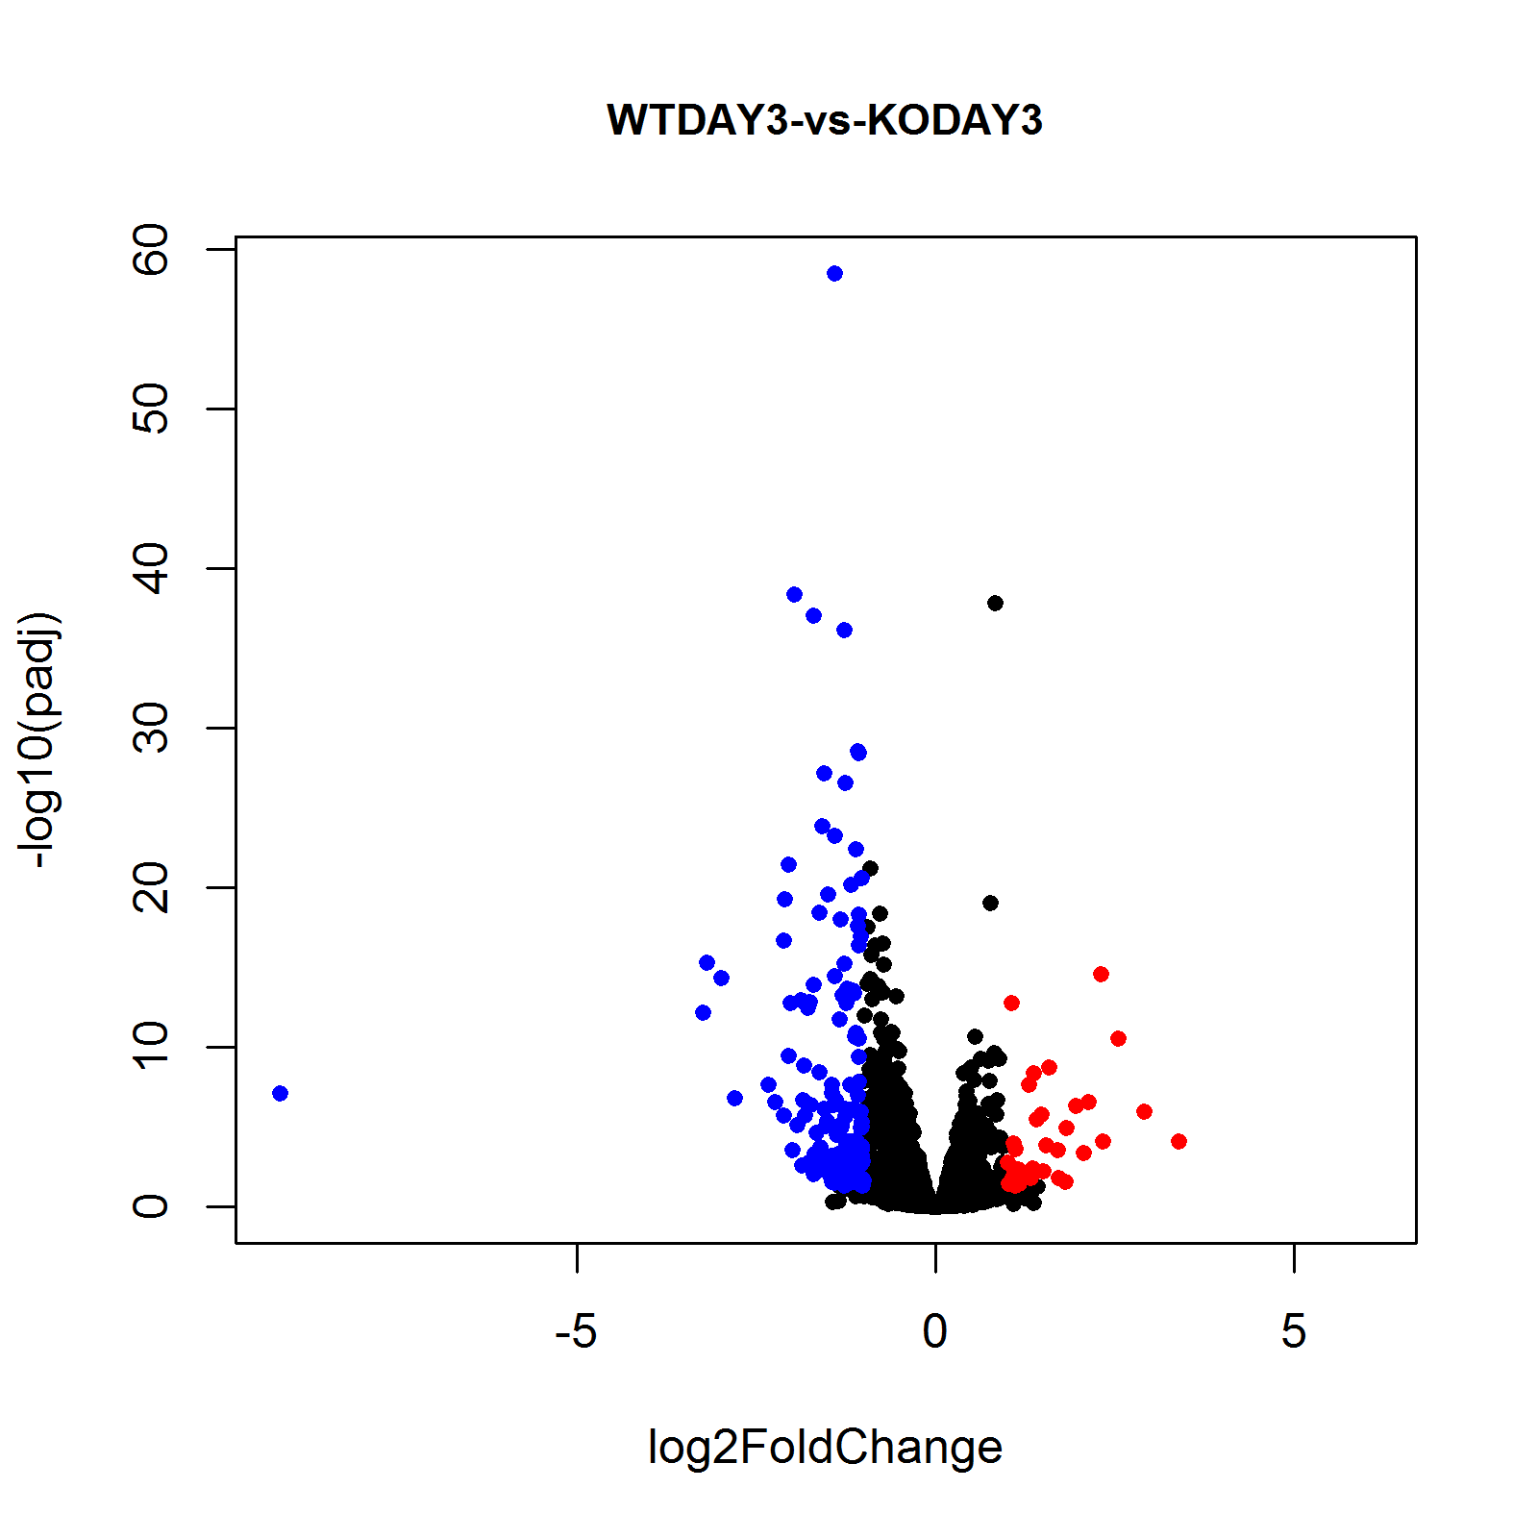
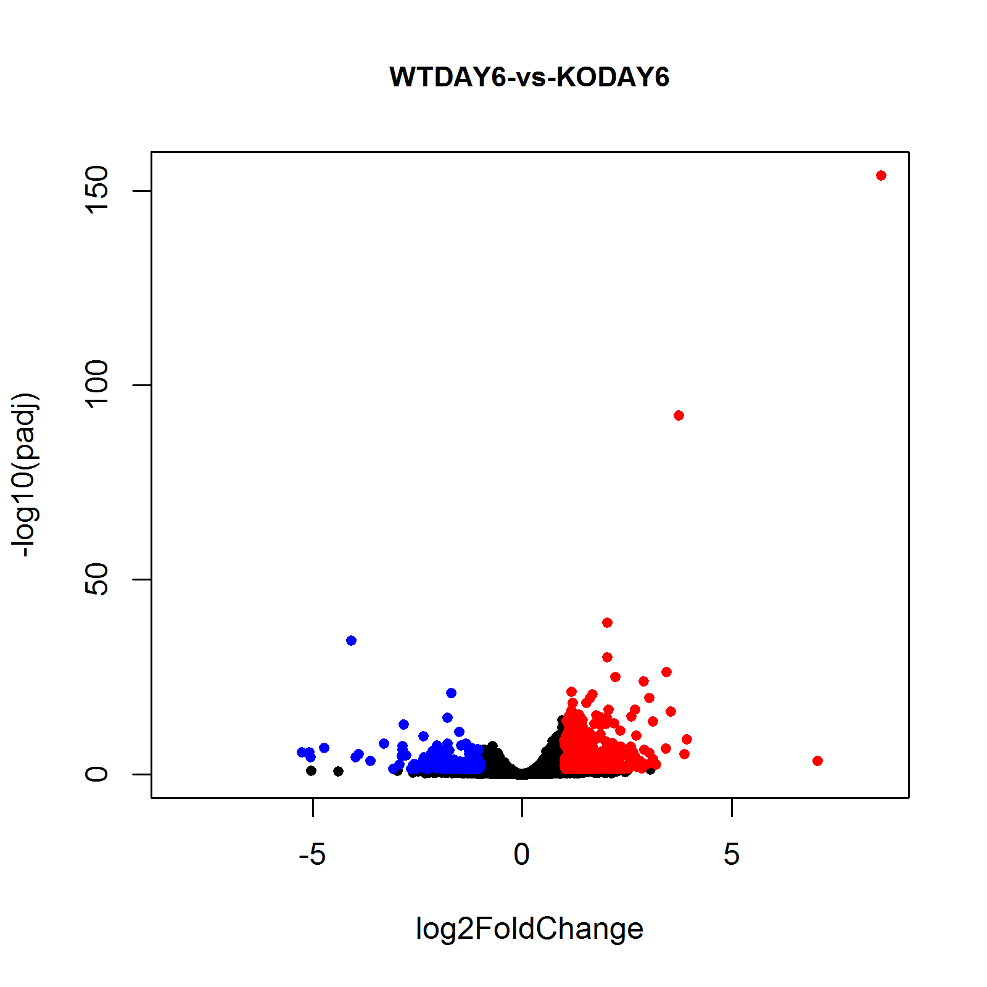
Additional plots: Volcano Plots

